Slide 1
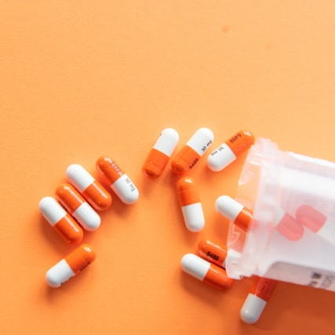
Medicine Analytics
Group-10
Chinmay Chamoli
Yashu Bhati
Jenson Puthenpeedikayin Jacob
Nahush Krishna

Slide 2


INTRODUCTION
Throughout history, medicine has been administered in many forms.
Communal healers
Home remedies
Concoctions provided by shamans
Discovery of medication by scientific innovation
Innovation in medicine is a continuous process, and by constantly improving the quality of the medication and finding the ways to remove side effects will ensure that the company maximizes its profits while providing safer medication to patients in the long term.

Slide 3
OBJECTIVES
To show the top brands and medication types that are being used in the country (Bangladesh).
To analyze the most recommended medications, the companies selling such medications.
To provide a list of the top medications.
To analyze the benefits and risks associated with using various medications
To recommend the best dosage form based on company and brand.

Slide 4
PROBLEM STATEMENT
Multiple manufacturers produce a variety of products for different health related issues. Therefore, there is a need to analyze how many different brands are available and the kind of dosage form that each manufacturing company prefers.

Slide 5
DATASET DESCRIPTION
Dataset Link: https://www.kaggle.com/datasets/ahmedshahriarsakib/assorted-medicine-dataset-of-bangladesh
21714 rows & 8 columns as below
Brand name
Type
Dosage form
Generic
Strength
Manufacturer
Package container
Package size

Slide 6
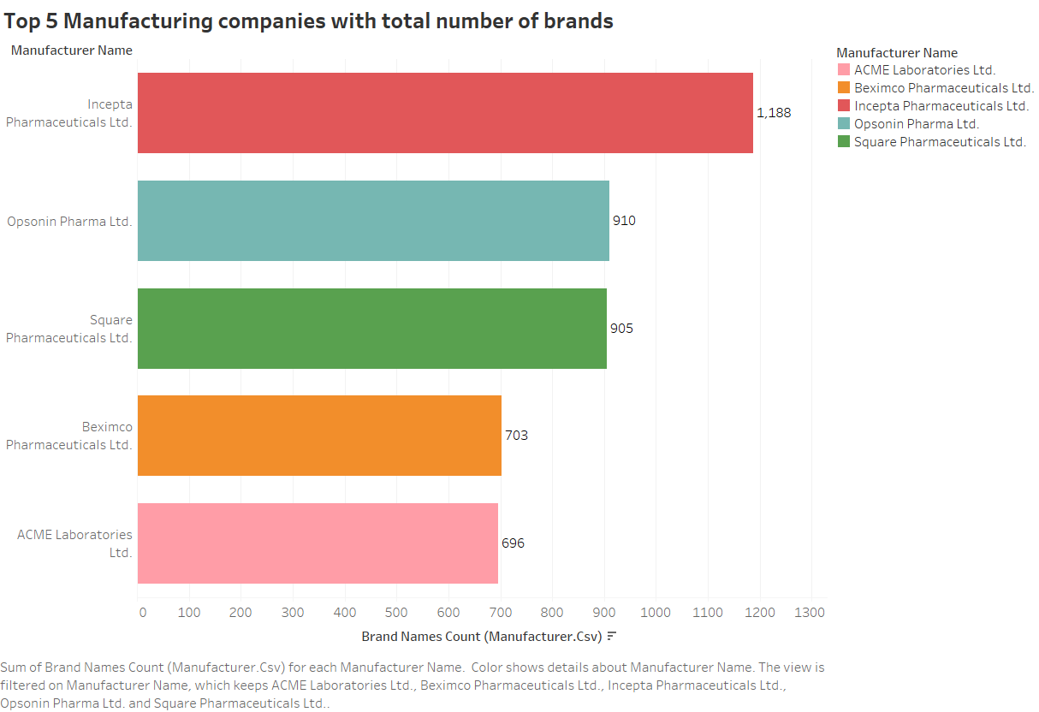
EDA
We observed that Incepta Pharmaceuticals Ltd. has 1,188 brands and is the top manufacturing company.

Slide 7
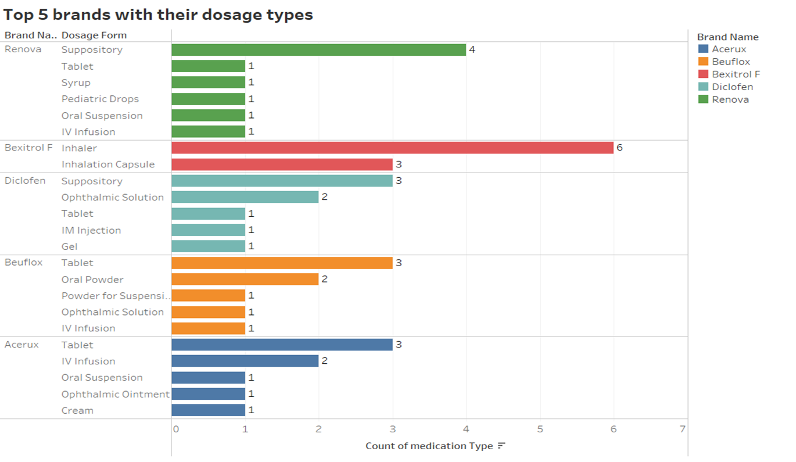
EDA
We observed that most of the brands had tablet as their dosage form.
Except Bexitrol F, since this was a medication for respiratory issues and offered inhalers

Slide 8
METHODS
Logistic Regression
XG Boost
RF Classifier

Slide 9
RESULTS (Logistic regression)
)
Accuracy: 0.76
Precision: 0.64
Recall: 0.76
F1 score: 0.69

Slide 10
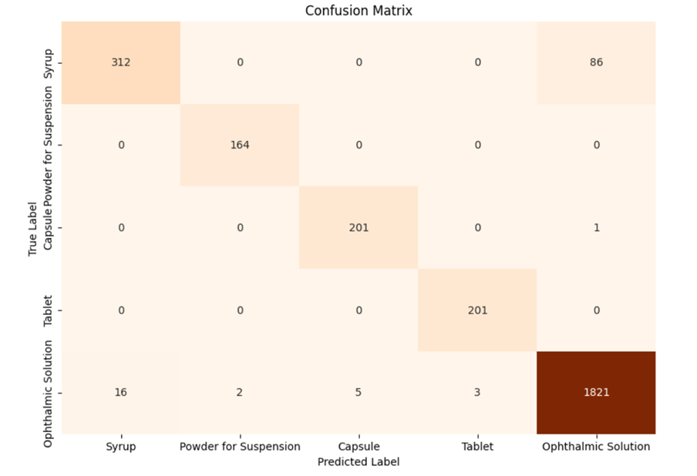
RESULTS (XG Boost)
)
Accuracy: 0.97
Precision: 0.97
Recall: 0.99
F1 score: 0.98

Slide 11
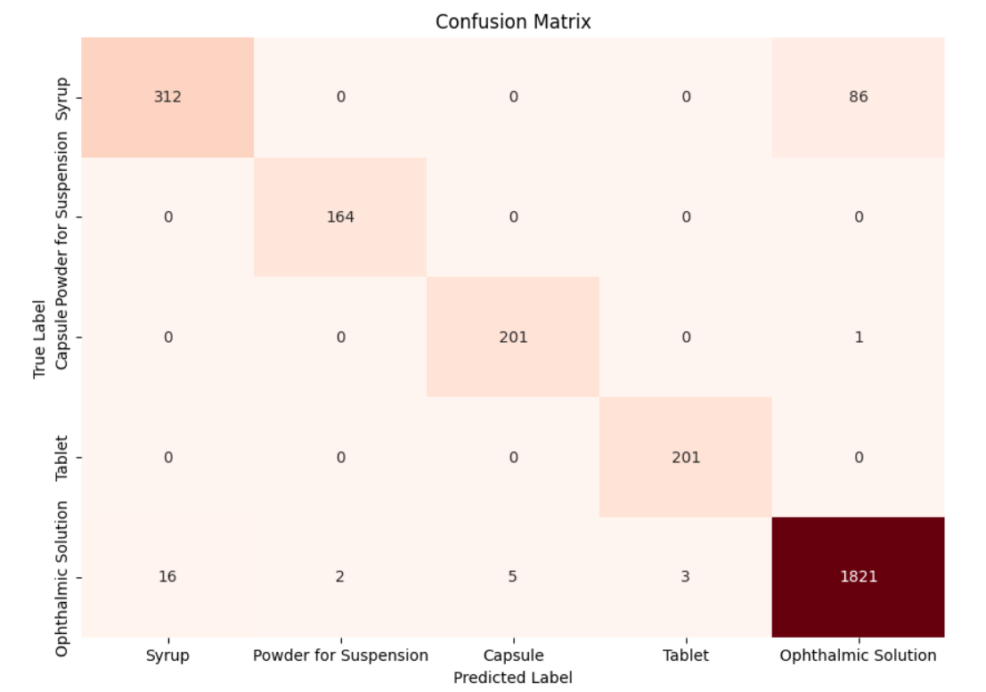
RESULTS (RF Classifier)
)
Accuracy: 0.95
Precision: 0.97
Recall: 0.95
F1 score: 0.96

Slide 12
RESULTS (Best Model Selection)
)
Since the accuracy of XG Boost was higher, we opted for XG Boost model for analysis.

Slide 13
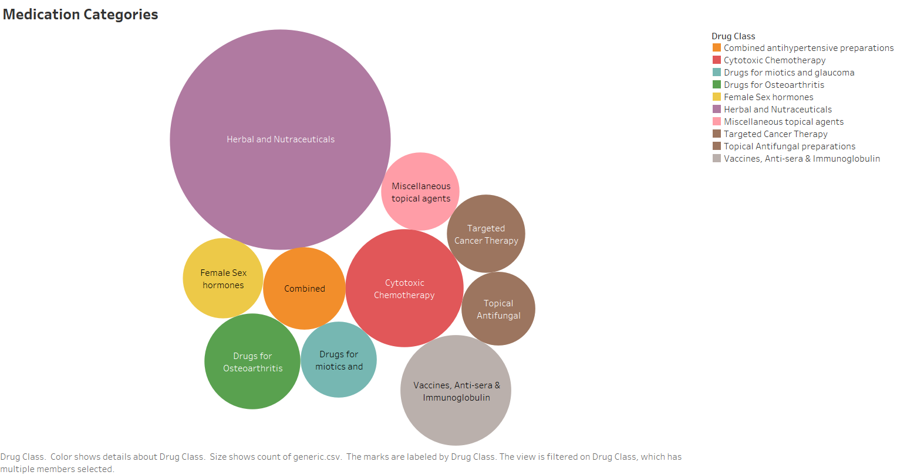
RESULTS
We observed that manufacturing companies had multiple brands of medication which improved overall health and immunity (Herbal and Nutraceuticals). This helped us realise that the companies believed that they could maximize profits since these were everyday over the counter meds that any individual could use irrespective of whether they were healthy or sick.

Slide 14
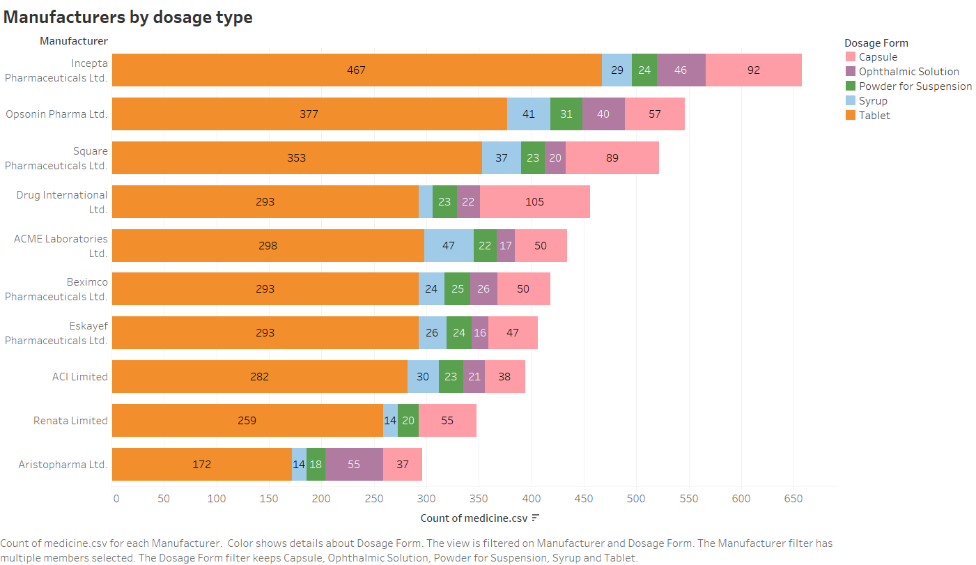
RESULTS
From the graph, we analysed the priority of dosage form and how many brands used the dosage forms per company.
We can observe that Incepta is providing Tablet dosage form of 467, while Aristopharma provides only 172 tablet dosages.

Slide 15
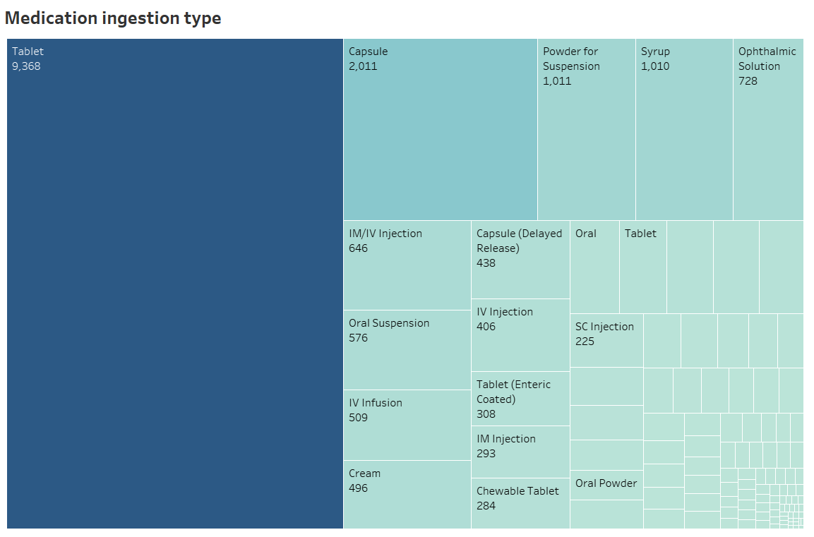
RESULTS
From the graph, we observe that most of the brands use tables as the dosage form followed capsule and powder.
Surprisingly, we had assumed that syrup be higher than powder, but the analysis showed us otherwise.

Slide 16
CONCLUSION
We were able to predict the dosage form of the drug based on the manufacturing company and the brand, therefore, we successfully did predictive analysis.

Slide 17
FUTURE WORK
We believe that by performing medication analysis, we can help patients gain access to medications that can effectively help them based on their body type, gender, and age.
Also, we could help analyze the long term and short-term side effects of each medication and customize it for the patient to help them minimize the consequences of these side effects.
We couldn’t perform cost analysis of each brand since, we could not find the price for each medication in any of the columns.
Doing an analysis of price will also help the patients get affordable medication for their medical issues.

Slide 18
REFERENCES
Medicare Part D Spending by Drug
https://catalog.data.gov/dataset/medicare-part-d-spending-by-drug-401d2
How drug marketing may influence prescriptions. (2017, May 18).
National Institutes Of Health (NIH)
https://www.nih.gov/news-events/nih-research-matters/how-drug-marketing-may-influence-prescriptions
10 Essential Facts About Medicare and Prescription Drug Spending. (2019, February).
The Henry J. Kaiser Family Foundation.
https://www.kff.org/infographic/10-essential-facts-about-medicare-and-prescription-drug-spending/

Slide 19

THANK YOU

